Slide 1
The future of the past ICT and classical art: CLAROS
Donna Kurtz, Beazley Archivist and Professor of Classical Art, Faculty of Classics
Notes:
Alumni Weekend
Good afternoon, ladies and gentlemen. Thank you for coming. This title is slightly different from the one in your brochure, but the message is the same, and perhaps clearer.
I am an archaeologist/art historian directing a research unit in the faculty of Classics. My accent reveals that I am an American who came to Oxford to do a doctorate on a Marshall Scholarship. I have never left Oxford and over more than 40 years have taught many undergraduates and graduates. I have very genuine interest in Alumni.
Four technical experts will join me in this presentation. Each will introduce himself. After the presentation all five of us will be happy to take questions.

Slide 2
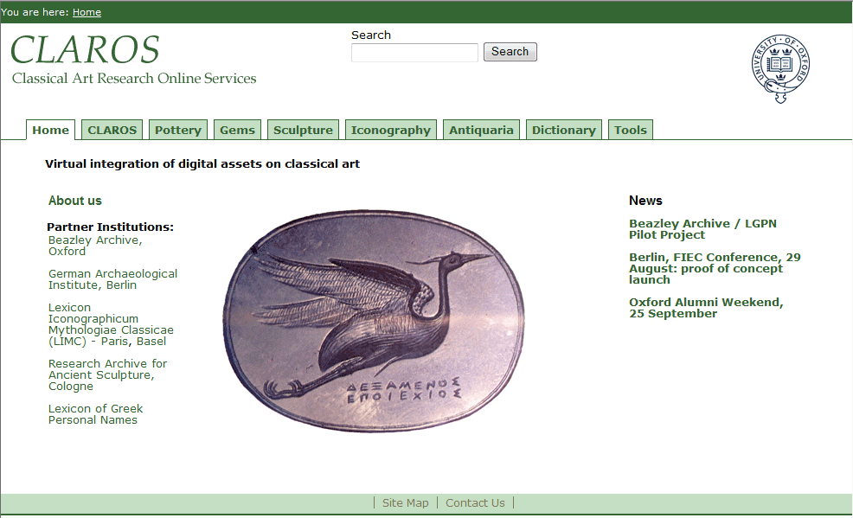
Notes:
What is CLAROS?
It is a web resource free to the public which integrates digital assets virtually – in new technology that we hope you will find exciting.

Slide 3
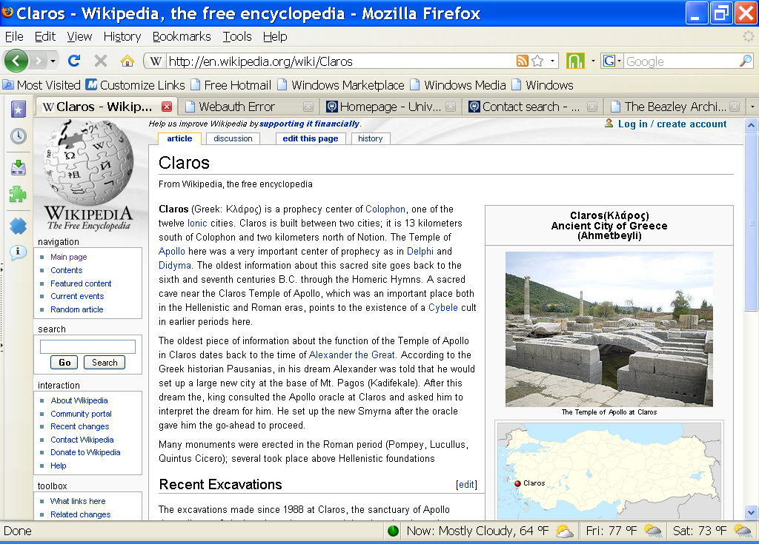
What is CLAROS?
Notes:
When many of us find an unfamiliar term we go to the web.
You might look for the term CLAROS in Wikipedia . You will find that CLAROS is an ancient Greek archaeological site on the western coast of modern Turkey. This area was settled by Greeks from the 2nd millennium BC and in classical times the Greek city of Claros had a famous oracle.
We might like to think that the prophetic powers of Claros bode well for our ground-breaking ICT project!

Slide 4
Classical Art Research Online Services
Collaborative research initiative led by the University of Oxford
Two areas of multi-disciplinary research
Classical antiquity
Information and Communication Technologies
Two aims
Enhance and disseminate the highest level of scholarship to the broadest global public
Use datasets in Classics and Classical Art to exploit the potential of ICT for public service
Notes:
In fact, the ancient site and its famous oracle had nothing to do with our choice of the name.
We needed an acronym for Classical Art Research Online Services – a name we had already chosen for the Beazley Archive’s new role as the University of Oxford’s Classical Art Research Centre.
CLAROS is best described as an international collaborative research initiative. It is led by Oxford but works closely with colleagues on the continent. It engages actively in research in two fields – classical antiquity and ICT.
The Vision for CLAROS can be traced back to the Beazley Archive’s participation in EU R&D projects in telecommunications in the 1990s.

Slide 5
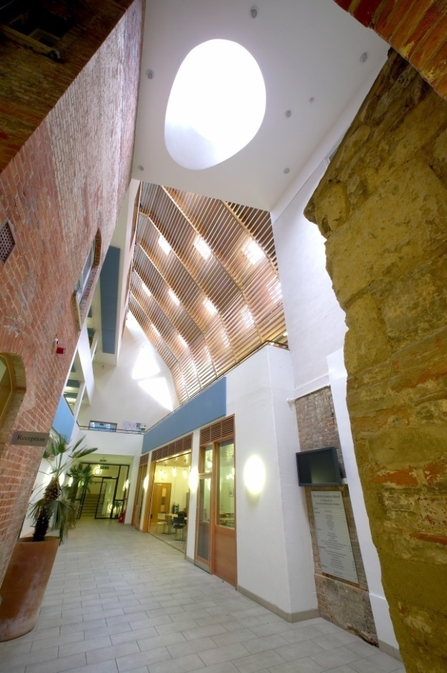
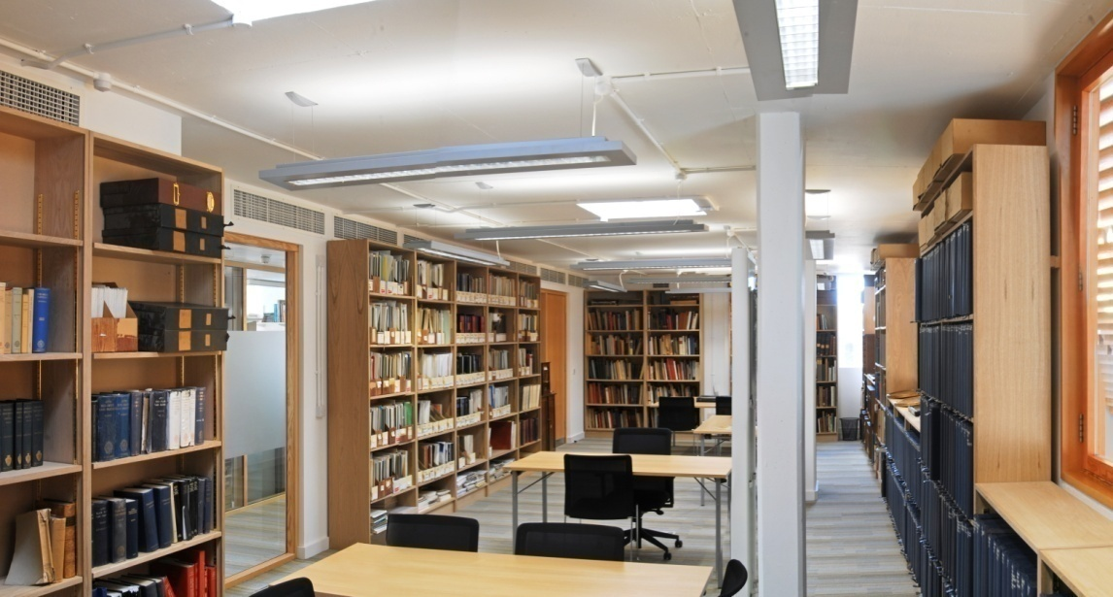
Ioannou School of Classical and Byzantine Studies, opened in spring 2007
The Beazley Archive Library
Atrium of the School
Notes:
This international multi-disciplinary initiative is led by the Beazley Archive, from its new home, in the Ioannou School, adjacent to its old home in the Ashmolean Museum.
The two 19th century houses in the foreground, where you see the brickwork, were joined to a new building in the background. The Archive is on the top floor.
The Archive collaborates with Classics, Archaeology, History of Art and Museums and Collections. It has always had strong links with international research centres.

Slide 6
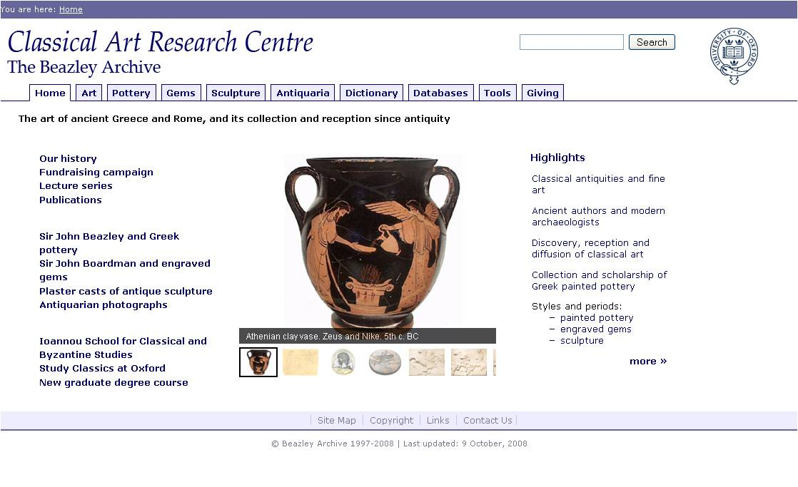
Notes:
The Beazley Archive site is the model for the CLAROS site. It was chosen by the University for presentation at the World Economic Summit at Davos this year as its best exemplar of broad dissemination of high value academic content.
The site receives about 250,000 hits each day because it was designed to serve a broad public: Dictionary and Tools guide the non specialist, as do subject tabs for browsing by object type. The search box can find any type of information on the site. Scholars can go straight to the datasets.
Public access to high level scholarship is fundamental to the CLAROS vision, as is the right of every content provider to his own IPR. In CLAROS the content provider’s data remain unchanged and the form of the parent web site remains unchanged.

Slide 7
Notes:
The arrival of the web in the mid 90s gave us a platform for delivering classical culture to anyone, anywhere, at any time. We could reach the international higher education community and the broad public, museums and libraries, schools and homes.
By transferring the Archive’s web model to CLAROS the data of our colleagues listed on the left side of the Home Page can be delivered to many different types of users at the launch of the system.
You will notice that one of our colleagues - the Lexicon of Greek Personal Names - is clearly not an art resource. Like the Beazley Archive it is an Oxford-based British Academy Major Research Project with an equally long track record of ICT development - over 30 years.
The Lexicon reminds users that classical art comes from literate societies. Since Greek names also appear on Greek art the two resources are complementary. Together we show how classical literature and art became the foundation of western culture, and we highlight the extraordinary richness of the university’s Faculty of Classics.

Slide 8
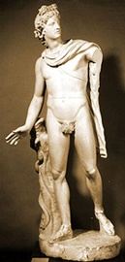
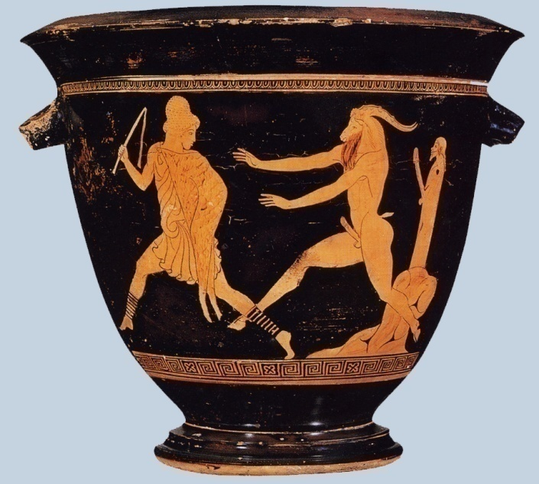
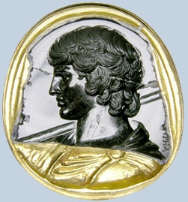
What is classical art?
The art of the ancient Greeks and Romans
Pottery Gems Sculpture
Notes:
The art of ancient Greece and Rome – sculpture, architecture, painting, pottery and gems, bronzes and terracottas - is known, collected and exhibited in the great museums of the world.
The CLAROS colleagues have spent thirty years documenting objects held in these museums. We have effectively created online catalogues.
Today CLAROS has more than two million records and images; and there are many more to add.
We began with established world leaders in electronic documentation and with Open Source software recognised by the International Standard Organisation.
That enabled us to build a platform for future development that was understood and valued globally.
CLAROS will welcome new institutional members with sizeable datasets and it will engage with the public.

Slide 9
Notes:
CLAROS virtually integrates the digital assets of the content providers on the left.
A user can search across all of their assets by typing a term in a search box. Alternatively he can select a tab for a specific type of object.
Greg Parker and Graham Klyne will describe the datasets and the programmes used to integrate them virtually.
They will also demonstrate some of the applications CLAROS already has for expert and novice users.
For one type of material, pottery, Andrew Zisserman and his team have already created an image recognition facility that will enable you to upload an image from you mobile phone.
And realising that our intellectually rich and varied material can be somewhat daunting to a non-specialist Yorick Wilks will show how his EU Companion Project can be adapted to guide you.

Slide 10
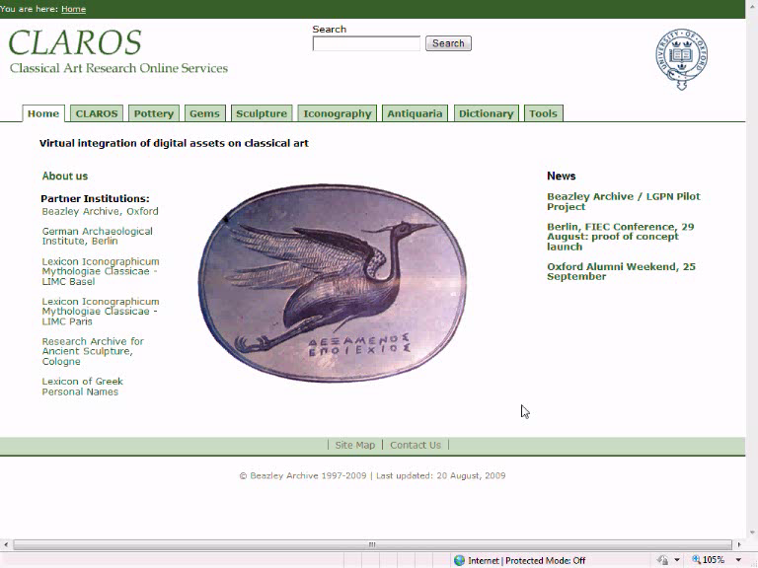
Notes:
[this is where the screencasts of the demo go. I talk over them], then I hand over to Greg who talks about the assets of data providers, how he created the CLAROS Explorer, and how it has helped us to make our information accessible]

Slide 12
Data
University of Oxford – Beazley Archive
Electronic documentation started 1979
150,000 Pottery records and 130,000 images
50,000 Engraved gem and cameo records and 30,000 images
900 Plaster casts records (classical sculpture) and 1000 images
900 Antiquarian photographs
University of Oxford - Lexicon of Greek Personal Names
Electronic documentation started 1975.
400,000 recorded individuals. Over 35,000 unique personal names.
University of Cologne – Research Sculpture Archive
Electronic documentation started 1972
250,000 Sculpture records, 490,000 images.
Notes:
I have been working with the Beazley Archive for many years on the IT side, developing systems to manage the data researched by the Archive, and present it in different manners over the years as technology has evolved.
We started working with the data from our partners many years ago on an informal basis, but it was the CLAROS project that finally gave us the opportunity to link together the vast resources of our partners.
The list on the screen gives you an idea of the volume of data we are talking about. From the Beazley Archive, The Lexicon of Greek Personal Names, The University of Cologne...

Slide 13
Data
German Archaeological Institute
1,500,000 photographs
University of Paris X - Lexicon Iconographicum Mythologiae Classicae
Created 1972.
100,000 records, 180,000 images of mythological and religious iconography from 2,000 museums and collections.
Total
2 million records and images
Notes:
..Through to the German Archaeological Institute and the University of Paris.
Together we have more than 2,000,000 records and images.
We further aim to map the LIMC datasets in Basle, Athens, Heidelberg, Wurzburg and elsewhere meaning there will be many more than 2 million records.
Further in the future we hope additional partners will make their data available for searching.

Slide 14
Databases
Beazley Archive: ‘XDB’ – XML data, SQL Server Database, ASP front end.
Cologne Research Archive and German Archaeological Institute: ‘Arachne’ - MySQL database, PHP front end.
LIMC: MySQL database, PHP front end.
LGPN: Ingres relational database, also available as an eXist XML database serving TEI-XML data. XQuery front end.
Notes:
Each partner has developed his own database system over decades.
The current list is shown on the screen.
The technologies used over the years have changed greatly and will continue to change.
But the advantage of the CLAROS approach is that it doesn’t matter what the underlying database of each partner is.

Slide 15
Databases
The variety of databases demonstrates how other partners can join with relatively little effort.
No changes required to existing databases or programs.
Interchange of data is achieved by export of underlying data to CIDOC-CRM.
Notes:
The variety of databases demonstrates how other partners can join with relatively little effort.
In CLAROS each needs to make no change to his content, the format of his database, or to his web site.
Each also retains his data and his IPR.
CLAROS facilitates exchange of information; it imposes no restrictions on data providers.

Slide 16
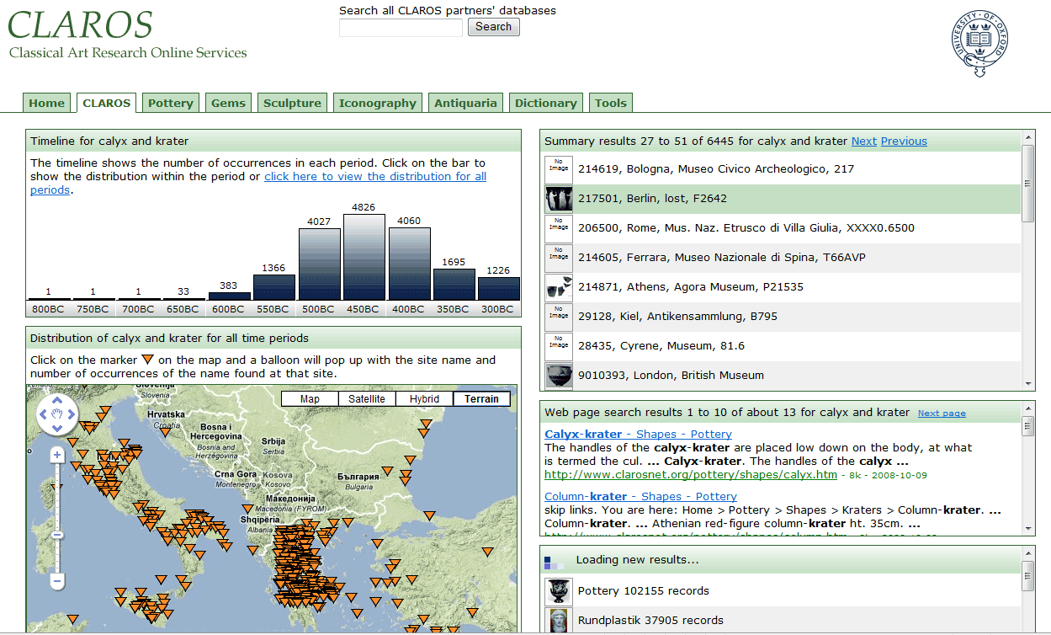
CLAROS Explorer
Each partner can integrate CLAROS data from the other partners using his own programming platform.
As an example Beazley Archive set up the CLAROS Explorer that you have just seen demonstrated to show what is possible.
Beazley Server
CLAROS Server
Search Request
CLAROS
ASP
Returned Data
User’s Web Browser
Format
Data
User
Interaction
JavaScript
Notes:
Each partner can integrate CLAROS data from the other partners and display it in a manner that suits his needs, using his own programming platform.
As an example the Beazley Archive set up the CLAROS Explorer that you have just seen demonstrated to show what is possible.
We use Active Server Pages as the main platform to generate interactive websites. We send a query request to the Claros server which we then format for display in the user’s web browser. We use JavaScript in the user’s web browser to provide the interactivity.

Slide 17
CLAROS Explorer – Further Development
Linked Multi-lingual Thesauri
HERAKLES -> HERCULES, HÉRACLÈS, ERACLE, HERACLES
Hierarchy of place names / geo-coordinates
GREECE -> ATTICA -> ATHENS -> ACROPOLIS
Notes:
There are further aspects that we aim to develop within CLAROS.
Each partner already has their own multi-lingual thesauri for their specialist fields, much of the information in 7 languages: English, French, German, Italian, Spanish, Greek and Russian. In CLAROS we need to link the partners’ thesauri to allow searches through the CLAROS Explorer in a simple fashion. For example we want a search on Herakles to return results also for Hercules.
In the demonstration you saw we gave distribution maps of results based on the geographical coordinates of each find place.
We also need to address the hierarchy of place names e.g. A search on the region Attica needs to return records found at all places within that region.
We also need differentiate places with the same name e.g. There are several places around the world called Athens and many Acropoleis.
To explain how we went about linking our datasets, I hand you over to Graham Klyne, the dataweb developer for CLAROS.

Slide 18
Contributing Partner Systems
Beazley Archive
DAI Arachne
LIMC (Paris)
LGPN (Oxford)
Relational
database: MS SQL Server
Relational database: MySQL
Relational database: MySQL
XML
database
.NET / ASP
XSLT, PHP
Java
XSLT
Browser
Browser
Browser
Browser
Notes:
Graham….
The CLAROS system provides a search and discovery service over the different data sources.
They have each developed independently over many years and each uses different underlying technologies to deliver information about the same very large subject.
Each also uses different technologies and different vocabularies to represent information.

Slide 19
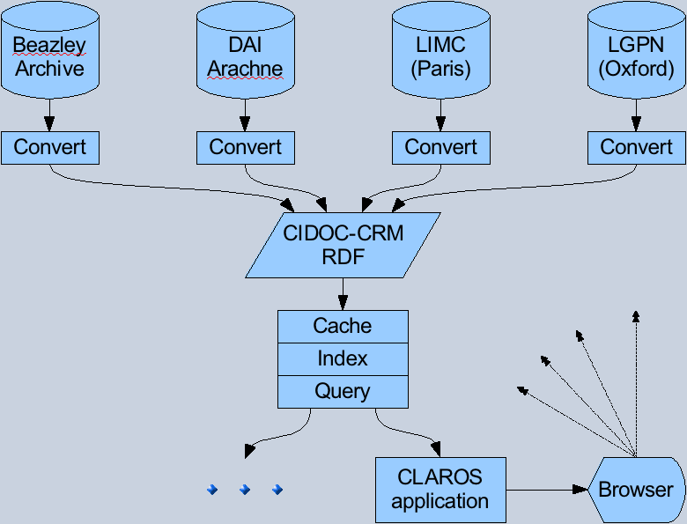
CLAROS System Components
Notes:
19
CLAROS needed a way to bring them together. Instead of developing our own bespoke system we looked very carefully at the work that had already been done and we found two standards that seemed to suit our needs.
The first is CIDOC-CRM. This is an ISO standard that was developed under the aegis of UNESCO for ICOM – for the world’s museums. We find that it offers greater potential for creating a common framework than other systems we have surveyed such as OAI, CDWA and MuseumDat.
It builds upon philosophical thinking and hard-nosed database experience to create a flexible framework and vocabulary for computer representation of scholarly knowledge about historical artifacts, places and events.
It also seems to be well suited to other domains, such as describing scientific experiments – the type of work that I usually do with computers - which hints at possible applications of this work beyond classical art.
The second standard we selected is RDF. This is a World Wide Web standard, a kind of universal data format and it is the base format for current work on the next generation of the Web, often called the “Semantic Web” or “Web of Data”. This data format eases the exchange of information between diverse software system components.

Slide 20
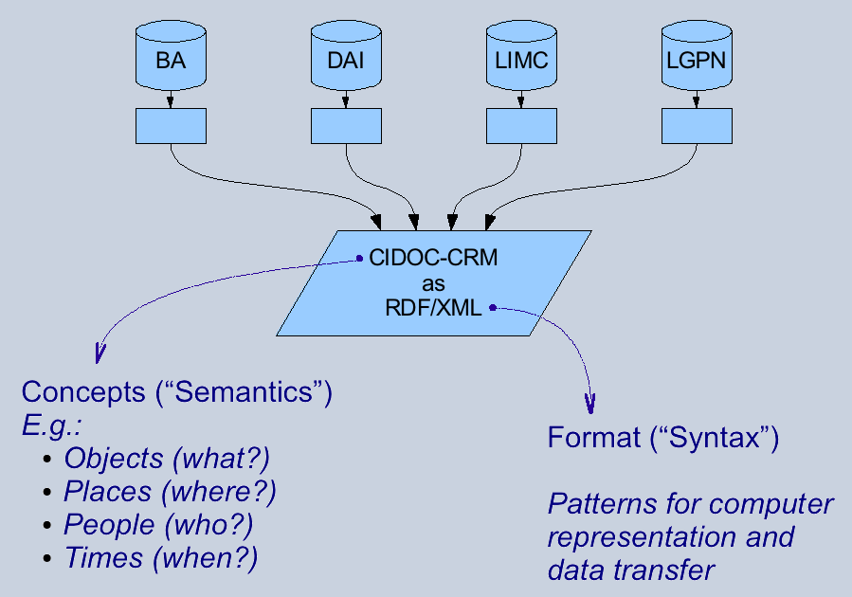
Combining Disparate Data
Notes:
Once we had selected the range data that we would cover with our search-and-discovery service, we needed to export it to the agreed form of CIDOC-CRM and RDF.
In most cases, this is a reasonably simple process of querying the source database and saving the results in the required format. This task need be programmed only once for each data source.
We also needed to learn how to exploit the potential of CIDOC-CRM for our rich data, and this was more challenging. The technical partners needed to understand the data of the content-providers.
Content providers and programmers have met regularly over the past year to discuss the formats that are most suitable.

Slide 21
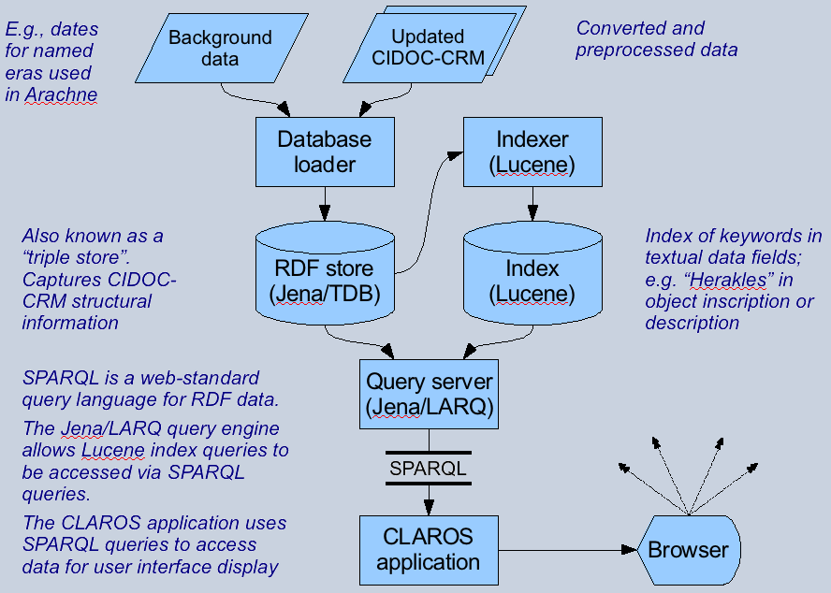
Technicalities
Notes:
21
The next step is making the data available through a query protocol called SPARQL. This is another Web standard that is supported by software from many providers, both commercial and open source.
CLAROS uses a particular implementation of SPARQL that works with Lucene, a widely-used software package that indexes keywords in free-text. This allows us to present queries that combine Google-style keyword search with structural constraints about the data. For example we can search for the word “krater” just in those places where it is used specifically to describe the shape of a Greek bpwl.
CLAROS also performs some pre-processing of the CIDOC-CRM/RDF data to simplify queries, improve query performance, include additional background information into the data, and to compensate for differences in the ways that different data sources present information.

Slide 22
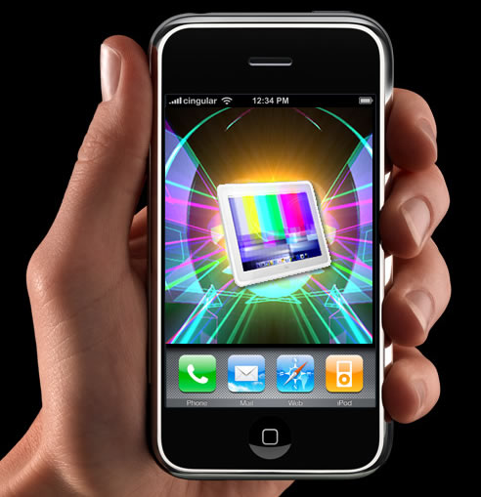
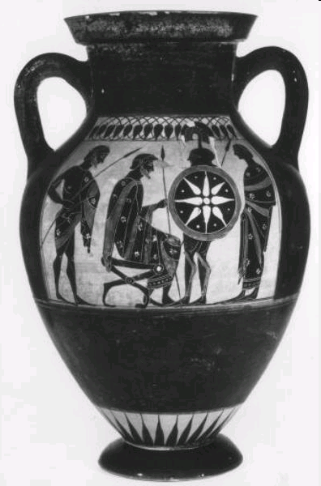
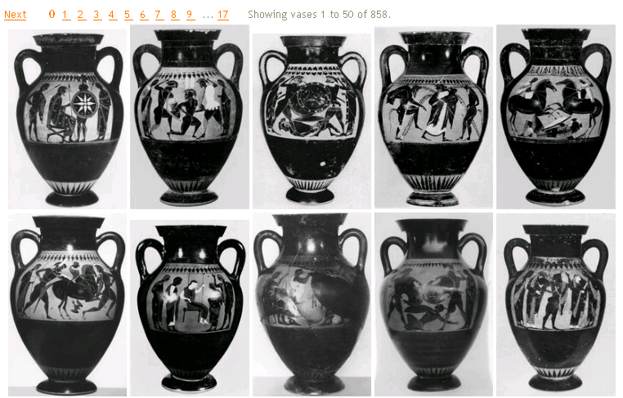
Image Recognition
Visually defined query
“It is an amphora
Data
… and here are similar objects in the archive”
What is this?
Notes:
Andrew…says something like this for the following slides
In the screencasts you saw how images of pottery could be recognised.
Since we study objects image recognition has great potential.
This type of technology is very new. When I showed Andrew Zisserman, a world leader in computer vision, the range of objects we study he asked if he could begin with the pottery. It is an ideal place to start because there are so many examples and the shapes are well defined.
The future will be dominated by hand-held devices.
Just as you can use an i[phone now to find a restaurant near your hotel you will be able to use it soon to learn about things you see.
You might see an object on the web or in a museum. You could upload it to your mobile phone.
Without using any words to search your image can be sent to the CLAROS site and you will be shown similar pieces.
22

Slide 23
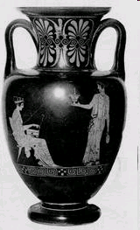
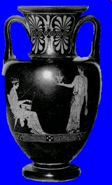
Shape Representation
foreground separation
silhouette representation
original image
vector
X₁
X₂
.
.
.
X_{n}
No representation of patterns or surface markings
100-dimensional “vase shape space”
Notes:
In order to do this the computer needed images.
We gave Andrew Zisserman and his team access to our 130,000 images of pottery.
He needed to create a ‘description’ of the object in each image – in this case, the shape of the vase, not the decoration or the material.
A number of processing steps were then carried out automatically:
first, the vase is separated from the background
second, the mid-line of the vase is computed, and the shape of the silhouette described in terms of its distance from this line
23

Slide 24
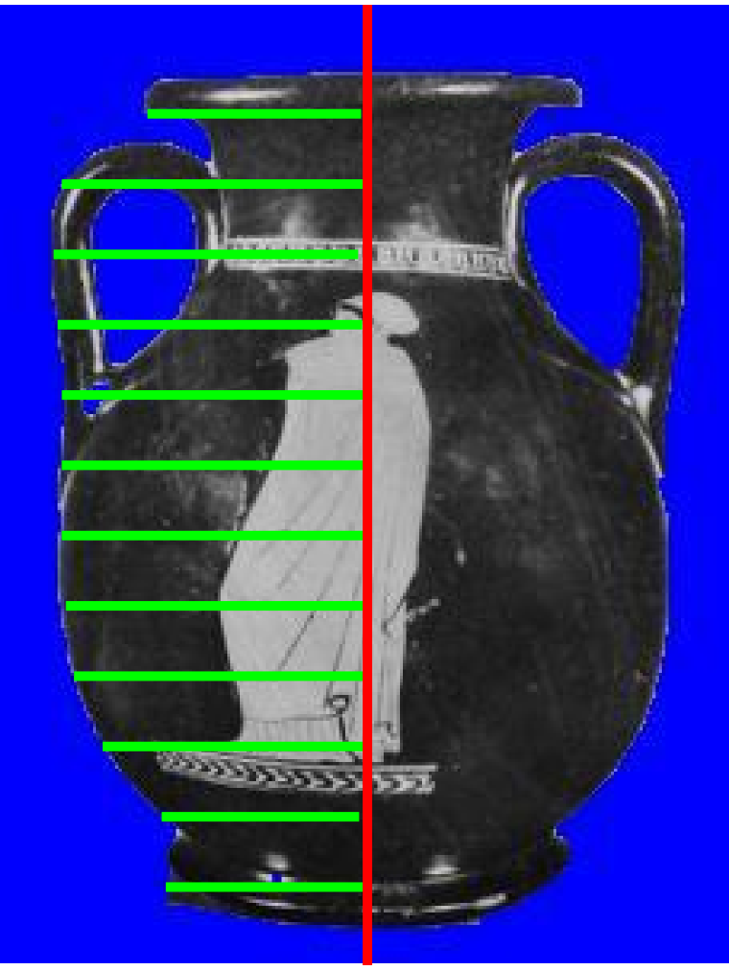
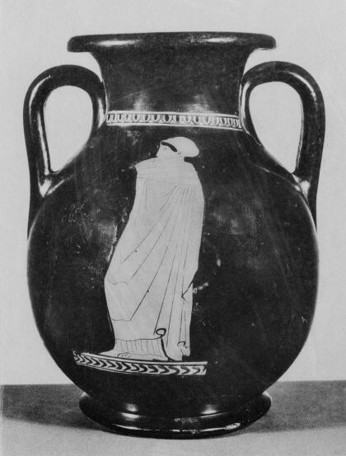
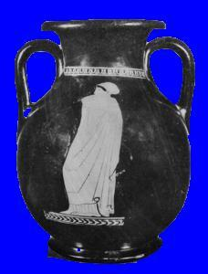
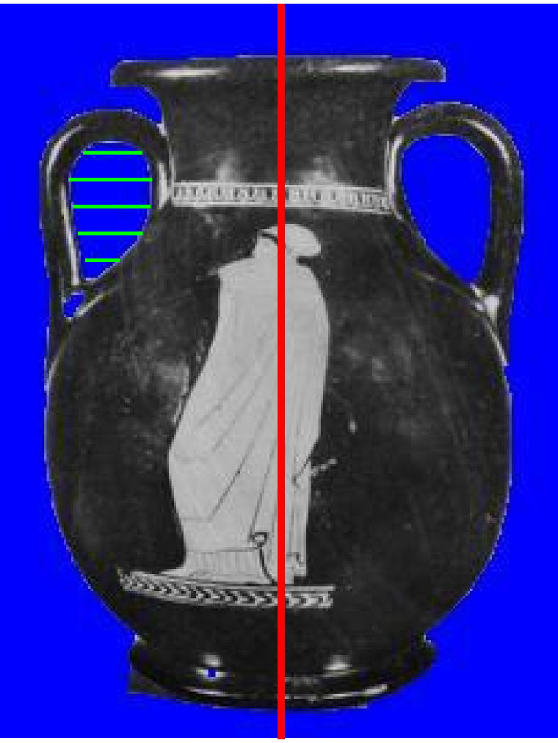
Shape Representation- details
silhouette (both sides)
handles
Notes:
Both the outer silhouette of the vase and the handles are described.
In this way each vase is represented by about 100 numbers, and each vase can then be thought of as a point in a 100 dimensional "vase shape space".
24

Slide 25
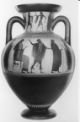
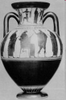
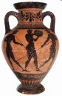
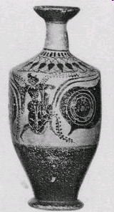
Vase shape space
Notes:
Vases with similar shape will be close together in this space, and those with different shapes further away.
A rounded shape with two handles – for example, the amphora above - is clearly nothing like a more cylindrical shape with one handle hidden from view – a lekythos below.

Slide 26
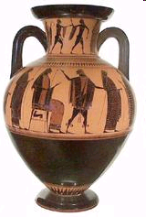
Compute three nearest neighbours for each vase
query
classify shape
all three are neck-amphorae
“judge me by the company I keep”
“vase shape space”
Notes:
This information can then be used to classify the shape of a new vase : if several of the ‘close neighbours’ all agree on the shape, then we can be confident that it does have that shape.

Slide 27
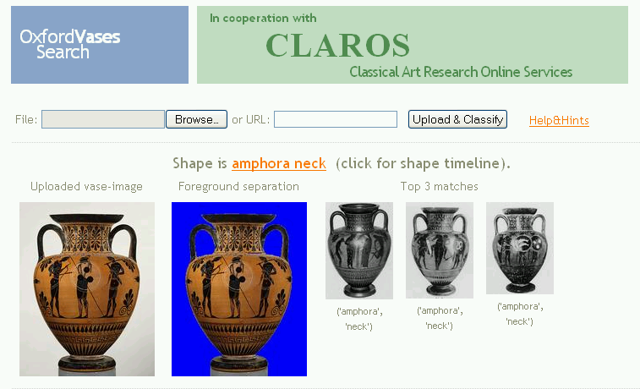
Step by step demonstration:
Step 1: upload image
Notes:
As part of Claros Andrew and his team have provided an on-line service to accept images, initially of vases.
The greeting web page looks like this, and a user can upload an image starting from the web or from a photo on his own computer.
27

Slide 28
Step by step demonstration:
Step 2: classify shape
Notes:
This example Andrew uploaded from the web.
The first image is the original upload (the query).
The second shows the separation of the vase foreground from the background - in blue. This separation processing takes a few seconds. The actual search, through 130,000 vase images takes a fraction of a second.
On the right are the images of the three closest vases, and they agree that the shape is 'amphora neck'
Clicking on 'amphora neck' then links to the Claros timeline and a map showing the distribution of where these vases were found, as you saw in the demo.
28

Slide 29
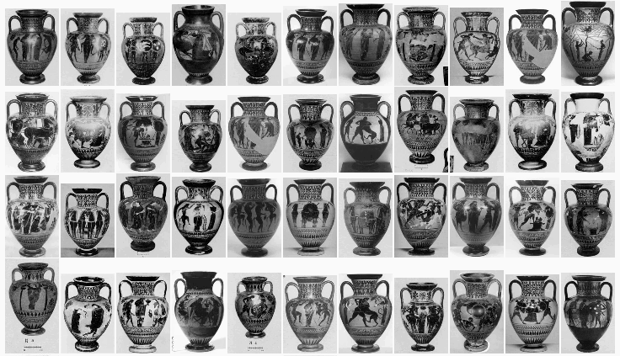
Step by step demonstration:
Step 3: matches in CLAROS
Notes:
And a list of similar vases in CLAROS is also provided, all ordered by similarity in shape to the query vase.
Clicking on ANY of these provides information about ts date, location etc. - taken directly from the Beazley Archive pottery databases.
We've illustrated the idea of searching by image with a vase, but we could use the same system for other objects in CLAROS, such as sculpture.
To help Rheinhard with his half million images of classical sculpture Andrew and his team only need to compute a new type of image descriptor.
It sounds simple but the technology is new and challenging.
And why are we doing this? After all. I could have told you it was an amphora –neck in a fraction of a second!
We are doing this primarily to broaden access: when there is no text in the search there are no language barriers. Anyone can search this way free and also be wholly from the constraints of the terminology that classical archaeologists have generated for centuries.
Looking farther ahead I see the potential for a global registry of antiquities that will engage with the public.
When a traveller, an excavator, a collector or a curator in a museum store sees an object and does not know what it is, he can upload it to CLAROS. An image recognition system can sort the sculpture from the pottery, the gems from the bronzes, and send each type of object to the centre where it is studied – for example, the sculpture to Cologne, the pottery and gems to Oxford. We identify the object, give it a unique record number and upload it to CLAROS where every one can see it.
This will greatly stimulate academic research.
29

Slide 30
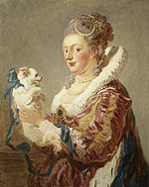
The Companions Project
Portrait of a Lady with a Dog, by Fragonard (1769)
Oil on canvas. Metropolitan Museum of Art, Fletcher Fund 1937, accession no. 37.118
Yorick Wilks
Oxford Internet Institute
Notes:
Yorick says something like this …
The image recognition system for pottery works now. We hope to implement the sculpture within a year or so.
Another thing we would like to do soon s introduce artificial intelligence.
….
Our subject is intellectually so rich it can seem to be inaccessible to those who have not had a classical education. Yorick and I think a companion could be helpful. Yorick chose the 18th-century painting to express the concept of a companion.

Slide 31
The Companions Project
E.U. Framework 6 Integrated Project
Multi-modal Interfaces (2006-2010)
www.companions-project.org
Notes:
ditto
A four-year EU-funded project to develop an ‘agent’ to reside on your computer, and learn about you and your preferences, to help you to access the internet more efficiently and more easily……………..
The Companion is not a robot and it does not need a specific platform. It can reside in your computer or mobile phone.
It learns about you and your preferences and it retains this information in its memory. That enables it to learn more about you the more you search. It can then automatically – without your intervention - extract information from anywhere on the web that it relevant – whether it is a text record or an image.
In the EU project, which is targeted at Europe’s aging population, it uses common data stores such as Facebook or Wikipedia.

Slide 32
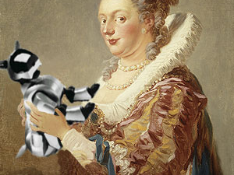
Fragonard and Wilks
Medicean lady with robo-dog
Notes:
ditto
The 16th c Medicean court lady is now holding a 21st c robotic dog. In the EU project the companion is an avatar - a small white dog with very large blue eyes and a big brown wig. I thought FIEC needed something more tasteful!
…….
Remembering Dante in the Divine Comedy, he chose Virgil.

Slide 33
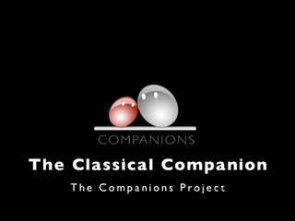
Notes:
Virgil video here

Slide 34
How can this technology advance scholarship?
Artificial Intelligence can build an agent and organize data
Human Language Technology (HLT) can recognize speech and some level of language content for a range of languages
The Companion can be a visible presence or invisible, and can talk to you in speech or text in your own language
Automatic extraction of data from the web can enhance and facilitate research – for example, from Wikipedia and Facebook
Notes:
I return for conclusion
If Virgil has unsettled some of you, I can assure all of you that he has a very serious academic purpose.
A Classical Companion could extract data from anywhere on the web automatically without the user’s intervention. He could accompany a scholar to museums or archaeological sites, but its greatest potential probably lies in making our subject accessible to anyone anywhere.
Since Human Language Technology already enables voice recognition in many languages the Companion could help us to cross language barriers.
If you found an avatar Companion tedious, he/his knowledge base could be transformed into text at the bottom of your screen.
And if Wikipedia and Facebook fill you with horror, please remember that at the outset CLAROS will have more than 2 million classical records and images, and that there are any other scholarly resources on the web, such as TLG, Perseus, etc. from which data could be automatically extracted.

Slide 35
Notes:
In conclusion, if we want subjects we love to have a future we must, of course, advance scholarship, but we must also make them accessible to the public in ways they can understand. In today’s world we must attract people’s interest and must sustain it. Technology can help us to fire the imagination, inspire learning and promote the scholarship.

